Slide 1
Vulcan Activity Tracker
CMSC-4920-Senior Project 2
Group2
Team: Margo Bonal, John Gerega, Luke Ruffing

Slide 2
Project Description
The Vulcan Activity Tracker is an athletic app that allows for the tracking of all campus athletics activities.
In one combined platform, the Vulcan Activity Tracker aspires to meet student organization needs, social interaction, and exercise goal planning in a free accessible way!

Slide 3
Weekly Progress
GOALS
Correct app rerouting error, login now required
Recovery email research – Resend application
User testing + feedback
Further challenges page development

Slide 4
User Feedback
Inform the user if they already have an account
Emojis next to activity types
User not found on login
Change usernames
Feature to delete accounts
Confirm password feature
Save an activity without an activity type
Left and right scrolling on the login screen

Slide 5
Hosting Research
**Current choice**
Azure Student
Render
Pros
$100 free credit (no credit card required)
Full SQL Server support (Azure SQL)
Production-level hosting (App Service)
Custom domain + HTTPS included
Cons
More setup complexity
Can accidentally use paid services
Credit expires
Azure portal learning curve
Pros
Very easy setup
Connect GitHub → auto deploy
Simple UI
Free tier available
Cons
Free apps sleep after inactivity
Limited resources
No native SQL Server
(would need Postgres)
*Out of Scope DB restructure

Slide 6
Challenges
Solutions
Rerouting difficult to fix since pages dynamically loaded
Use of local host insecure
Email Password Recovery – Backend
CSS style conflict
Added login required wrapper function,
set all pages to private unless login
Clear upon logout to reset
Added session key so current user is stored upon login, removes insecure local storage logic
Still being worked on
Renamed styles to better match use

Slide 7
Progress
Vulcan Platform
Database

Slide 8
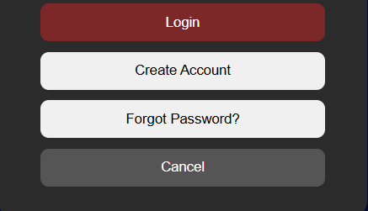
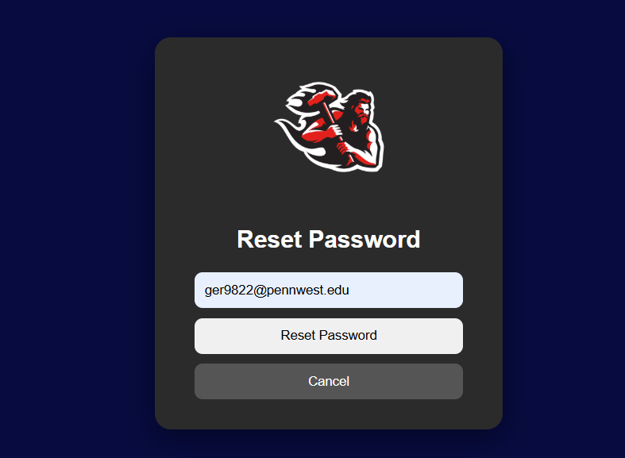
Reset Password Recovery

Slide 9
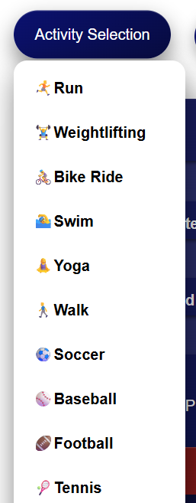
User Feedback Enhancement

Slide 10
Week 8 Plan
Fix Email Backend issue
User Profile Section
Continue development on other pages
Maps Page

Slide 11
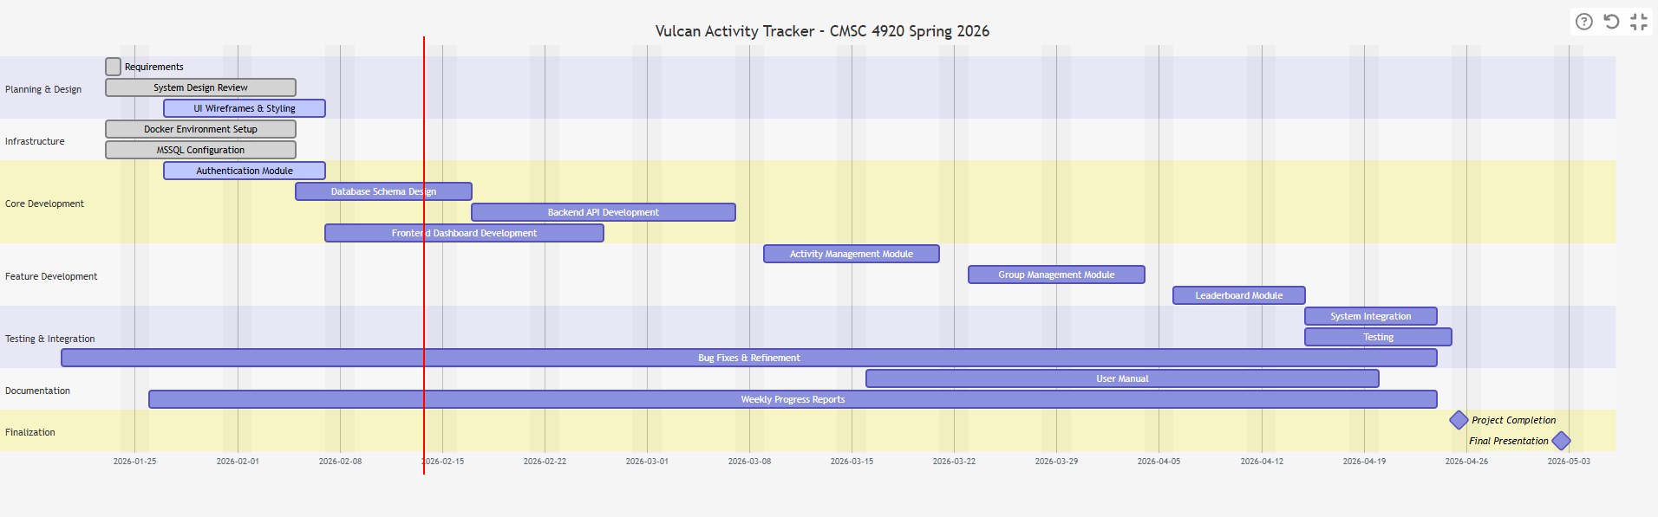
Planning
Gant chart

Slide 12
Website: https://jjdeuce06.github.io/VulcanActivityTracker/

